Slide 1
UM-Plan: Strategic Financial Planning & Analysis Tool
Submitting & Approving Budget/Labor Plan Files
Last update: November 2021

Slide 2
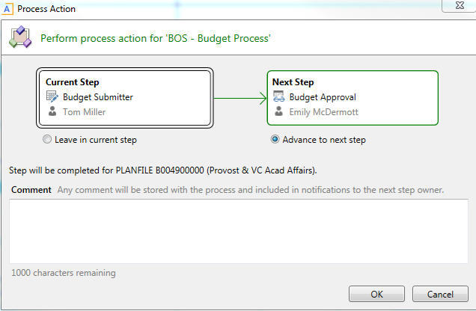
Submission – From Save
When saving a process action window will appear “Advance to next step” to move the plan file to the next step in the approval process
You can add comments which will be saved with the Plan File and forwarded to the next step

Slide 3
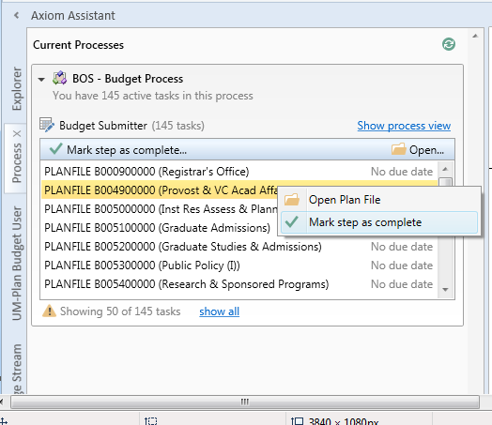
Submission – Process Task Pane
In the Budget Submitter section of the Process task-pane you will see plan files available to submit for approval
Right clicking on a plan file will give you a choice to open the plan file or mark step as complete

Slide 4
Submission – Process Task Pane
Selecting Mark step as complete will open the process window where you can enter a comment to be stored with the Plan File and forwarded to the approver
Clicking Ok will submit the Plan File for approval or cancel to close without submitting

Slide 5
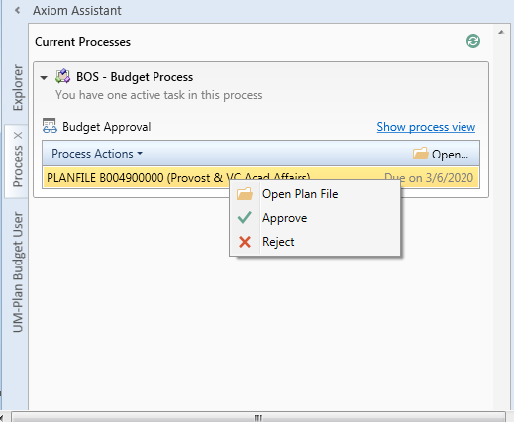
Approval Process
In the Budget Approval section of the process task pane you will see plan files awaiting your approval. By right clicking on a listed plan file you can open, approve, or reject a plan file

Slide 6
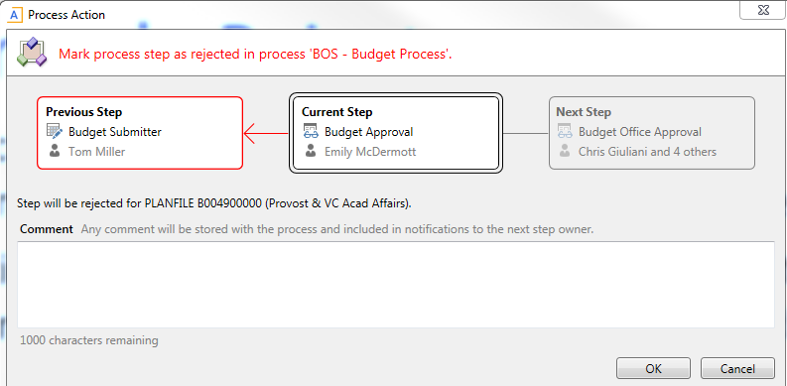
Approval Process - Reject
Selecting Reject will open the process window where you can enter a comment to be stored with the Plan File and sent back to the submitter
Clicking OK will reject the Plan File and return it to the submitter for editing and resubmission, or select Cancel to close without any changes

Slide 7
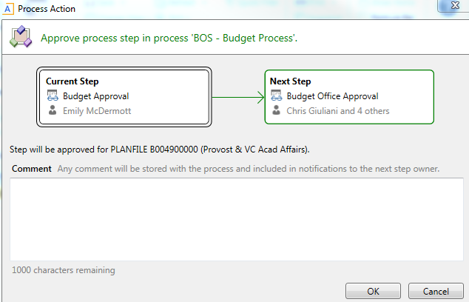
Approval Process - Approve
Selecting Approve will open the process window where you can enter a comment to be stored with the Plan File
Clicking OK will approve the Plan File and forward it to the next step or select cancel to close without approving

