Slide 1

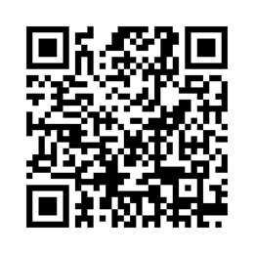
You are invited:
2025 CEHD Research
Extravaganza
WEDNESDAY, APRIL 30th• 4-8:00pm EST
Remote and In-Person at the UMass (Campus Center Ballrooms A & B)
The event features presentations, displays, and discussion. Expect food, music, drinks, and a festive atmosphere to connect with colleagues and meet people from across the college.
Contributions from research projects, organizations, programs, and personal work are welcome. Past submissions have included posters, information tables, visual art, video, and interactive demonstrations. Presenters have included faculty, staff, students, and college partners.
Undergraduate and graduate students and encouraged to contribute. Professors, please share this opportunity with your students and consider incorporating the event into your semester plans.
All are welcome to this annual celebration of the College of Education and Human Development at UMass Boston!
Questions? Contact:
CEHDResearch@umb.edu
To register to attend or present, please follow the QR link

